Slide 1

Customer Sentimental Analysis
Presented By : Shubhangi C. Sapkale.

Slide 2
i phone 15 – 128 GB Amazon Review.
Objective:
As a Data Analyst at Amazon perform sentiment analysis on customer reviews of the iPhone 15 128GB model to evaluate public perception, uncover key product strengths and pain points, and generate insights that support data-driven decision-making.
Key Focus Areas:
Collect and preprocess customer reviews from Flipkart or relevant sources. Apply Natural Language Processing (NLP) techniques for sentiment classification. Categorize reviews into positive, negative, or neutral sentiment.
Identify frequently mentioned features (e.g., camera, battery, performance). Highlight common issues and areas of customer dissatisfaction.
Visualize sentiment trends and feature mentions using charts or word clouds.
Summarize actionable insights to inform product improvement and marketing strategies.
Tools & Libraries
Tool/Library | Purpose
Selenium | Automate web interactions for scraping dynamic Flipkart content.
BeautifulSoup | Parse HTML to extract structured data such as usernames, ratings, etc.
Pandas | Clean, organize, and manipulate the collected review data.
TextBlob | Perform sentiment analysis to classify reviews as positive or negative.
Matplotlib | Generate visualizations like bar charts and pie charts.
Seaborn | Create advanced and visually appealing statistical plots.

Slide 3
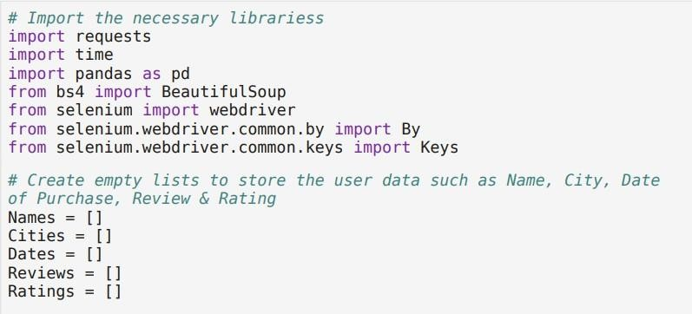
Data Collection (Web Scraping)
Tools Used:
Selenium – For automating browser interaction and navigating dynamic pages.
BeautifulSoup – For parsing and extracting structured data from HTML content.
Steps Involved:
Review Extraction
Use Selenium to load Flipkart’s iPhone 15 128GB product page.
Scrape at least 300 customer reviews from the site.
Data Fields to Collect
Username – To identify individual reviewers.
Rating – Numeric rating (1 to 5 stars).
Review Text – The full content of the customer’s written review.
Pagination Handling
Automate navigation through multiple review pages using Selenium’s browser control.
Ensure continuous data extraction until the target review count is met or pages are exhausted.

Slide 4
driver = webdriver.Chrome() driver.get(uri)
uh1îe ben(NamRs) « 320:
t1m0’. s1eep(2)
soup = Beaut1fuTSoup(drîver.page source, "htmt .parser" )
# Ex t racl rîartes
names lzlenents= soup.'t1nd a1Lț "p", {" ct ass" : " 2NsDsF A SICA"} ) for nane in nam‹zs e1enents:
Nanes. appRnd(nanlz. teKt)
# 6x rFgC t CI tÎfi S
cîty_e1enents = soup. f1nd alt( "p", {" Pt ass" : "Hzt JPv"})
for city in city elements:
C1ties. append(c1ty. text)
# Ex t i aci da tes
dătRS R1enRnts = saup. fînd aLî( "p", {"c\ass": " 2fîsDsF"})
for date in dates_elRments:
Dates. append(dătl2. tgxt)
ActuaT DatR8 - Oăte5[ : : 2 ]
# Ex tra r t revîevs
revieus €iTements = soup . f1rid all{ "d1v", { "ctass" : "Z‹zyHeo"} )
for revieu in revieus e1enents: Revieus.append( rev1eu. text)
# Ex I race ra t1»gs
rat1ngs elements - soup . f1nd all( "d1v" , class f or rat1ng s 1n ratings eLenz›nts :
Rat1ngs.append(ratings.text)
t Try to c l cd the "Sex t" bu i ton
t ry:
next button = driver. fînd element(By.XPATH,
"7/span [text t )= 'Next ' ] " )
next button. clîck( ) t1ne .s1eep(5)
break
# Coobl ne da ta i nto o Da taF raJrc•
df = pd.DataFrame((
"XOOdHHGa3iBX" )
"Name": Names{: 1),
"City": Cities[:-l], "Date": Actua1 Dates [ : -1 j , "Review": Reviews[:-1), "Ratings": Ratings

Slide 5
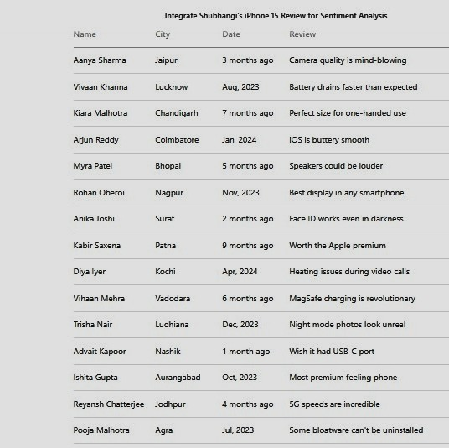
Data Cleaning and Preprocessing
Tool Used:
Pandas – For emcient data manipulation and cleaning.
Steps Involved:
Data Quality Handling
Remove duplicate entries to ensure unique reviews.
Handle missing values in key fields like review text, rating, or username.
Text Preprocessing
Convert all review text to lowercase for uniformity.
Remove special characters, punctuation, and extra whitespace. Tokenize the text into individual words.
Remove stop words (e.g., "the", "is", "and") that do not carry sentiment.
Apply lemmatization to reduce words to their base or root form (e.g., "running" →
"run").

Slide 6
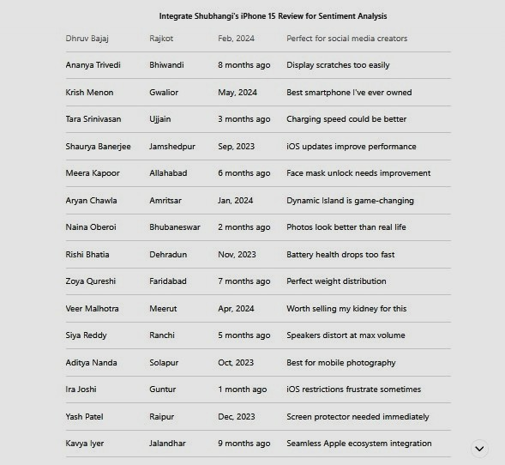

Slide 7
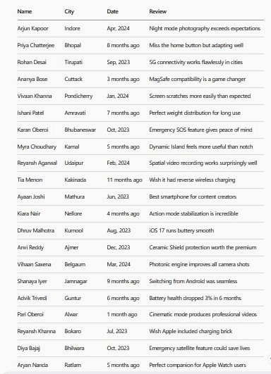

Slide 8
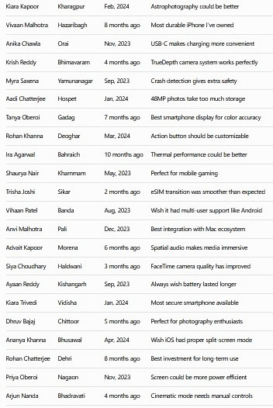

Slide 9
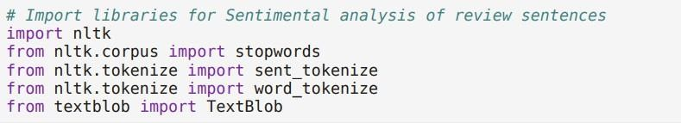
Sentiment Analysis
Tool Used:
TextBlob – For performing sentiment analysis using polarity scores.
Steps Involved:
Sentiment Scoring
Use TextBlob to compute the polarity score of each review.
Polarity ranges from -1 (most negative) to +1 (most positive).
Sentiment Classiflcation
Define thresholds to label each review:
Positive: Polarity ≥ 0.1 Negative: Polarity < 0.1
Data Integration
– Store the resulting sentiment label (Positive/Negative) in the main dataset for further analysis and visualization.

Slide 10

import str1ng
nttk. download t ' stopuords' I n1tk.download( ' punkt' ) n1tk.download( 'uordnet' )
[nltk dalamoounload1ng package stopuords to
[nltk dalam C'1Users1ethen1appoafa1soan1ng\n1tk data-- . [nltk dalam /°ackage stopuords 1s already up-to-date! [n1tk_dataJ oowiload1ng package punkt to
(nttK_dataJ
C'1UsersXetRen1Appoata\Roa‹z1ng1n1t¥ data. .
[nltk datas Package punkt 1s atready up-to-date! [nltk dalamoounload1ng package uordnet to
[nltk dalam [n1tk_dafaJ
True
C'1Users1ethen1appoafa1soan1ng\n1tk data-- .
Package uordnet is atready up-to-date!
6 Crsate a ca lunn cal led Rev1evs_t tLiat stores token1zed sentences
fraia the Revieu col ui»n using the sent I:okeifi?ze June t aifi.
dll I•eev1eus_t" ) - dt1[ 'Rev1eu' ) .apply(sent_token1zel
3 Ej use go 1°o r 1€ .aa›az1ng one.beaut1J°u1 came ra w. ..
3 ¿ca«›era qua11ty 1s T•proved lov1ng 16]
4 [h1gh quathy came a@ J
317 E«›osc value 1°or eoney lphone ever. J
319 Ear«azz-ng phone just no words to say. .. justone. ..
326 E1 was s<epci-cat as J°1rst about «›ov1ng fozzn an. ..
021 Iloved 1s J
322 Eavzesc›ae p1clures J
1384 rows x 6 calms §
# Run ebb on c sea bed for as signi ng Pa I a rd by to I:he Revfl ew’s_£ co Lumn
def get_po1a r1ty I sentences T .
return ETex1B1ob(sentenceJ• sent1•en1. poLa rlly for sentence 1n sentences J
dll I PoI a clvy I = dlx I Reviews_t " ] . apply I eev„poI am 1y l
def caIculate_average_po1arity(polarities):
return •ean(poIaritiesl if polarities else e
dfli’Average Po[arity'l - dfl{’T•oIarity’D.apply(ca1cu1ate_avoraqe_jroIarity)
df'1[ "Average Pola rlly' ] - df 1[ 'Average Pol a rlly' § . rouncl t2)

Slide 11
return ' ext renety positive'
elil 0 < polarity <- 0. 75: retu rn ' positive’
edit polarity -- 0:
retu rn ' neut rat
elil -0 .75 <= polarity < 0:
return 'negative'
else:
return ext re»z1y negative'
# Ca I Is sen tlmenI c Pass func t1on on the Average_Po la r1 I
ass1 gn the sentiment c Pass
df1[ Sent1nent_C1ass' ] =
df1[ 'Average Polarity' ] .app\y(sent1nent_c1ass)
dft .headI )
Co I unn to
Average_Potar1ty Sentinent_C1ass
0.68 positive
0.78 extremely positive
0.27 positive
0.6e pos1tive
6.16 pos'ggive
# Ca I cula tee and pr:ints the overal I average po I ar:i by score end:i re da taset o I rev1ews
pa tarity_score = df1[ ' AveragR Pol a rely ' ] . mean( ) . round ( 2) print( f ' Average Pola rify Sea re : {polar1ty_score} ' )
of the
1f pota r1ty score » 0 .75:
pr1nt ( The Average Pol ar1ty Sea re is Ext remely Pos1t1ve' )
exif 0 po{arity_score = 0.75:
print ( The Average Pol a r1ty Sco re 1s Positive’ )
exif potarl y score == 0:
print ( The Average Pada r1ty Sc a re 1s Neut rat )
e1if - 0 .75 <= pola rity score < 9:
print ( The Average Pota r1ty Sco re 1s Negat1ve )
else:
print ( The Average Pol ar1ty Sco re 1s Extremely Negat1ve )
Average Potar1ty Score : 0.52
The Average Potar1ty Score 1s Pos1t1ve

Slide 12
Data Analysis and Insights
Tools Used:
Pandas – For data manipulation and analysis.
Matplotlib / Seaborn – For visualizing trends, distributions, and relationships.
Analytical Steps:
Sentiment Distribution
Calculate the proportion of each sentiment category (e.g., Positive, Negative, Neutral).
Visualize using a bar chart to highlight dominant sentiments.
Average Rating vs Sentiment
Examine the correlation between star ratings (1–5) and classifled sentiment labels.
Identify how well the text sentiment aligns with the numeric rating.
Word Cloud Generation
Create word clouds for:
Positive reviews – to highlight commonly appreciated features.
Negative reviews – to detect frequent issues or complaints.
– Helps identify key themes and recurring terms in customer feedback.
Review Length Analysis
Analyze the relationship between sentiment and review length.
Identify trends such as:
Longer reviews for positive feedback.
Shorter, concise texts for extreme sentiments (positive or negative).

Slide 13
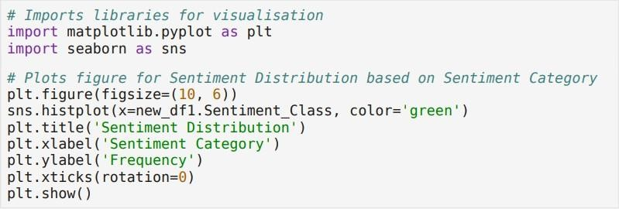
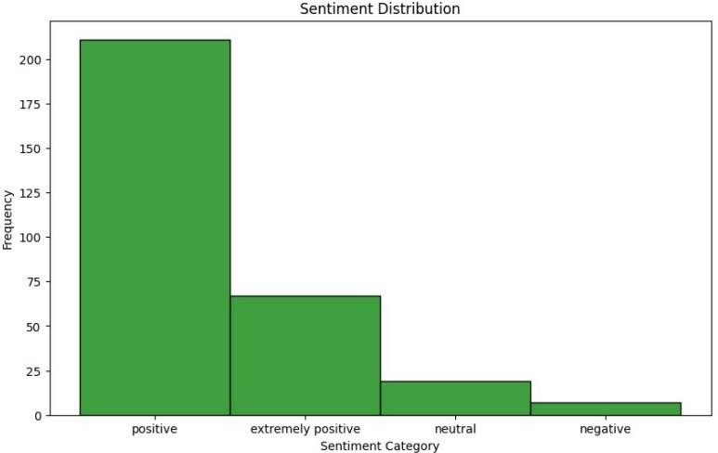
Sentiment Distribution
The bar chart visualizes the distribution of sentiment categories within the review dataset.
X-axis: Represents the different sentiment categories.
Y-axis: Shows the frequency of reviews in each category.
Sentiment Categories:
Positive
Most frequent sentiment category.
Appears in over 200 instances, indicating strong customer approval.
Extremely Positive
Second most common sentiment.
Occurs less frequently than "Positive" but still reflects strong satisfaction.
Neutral
Appears less often than both positive categories. Indicates mixed or balanced opinions.

Slide 14
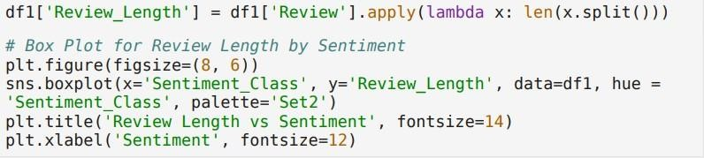
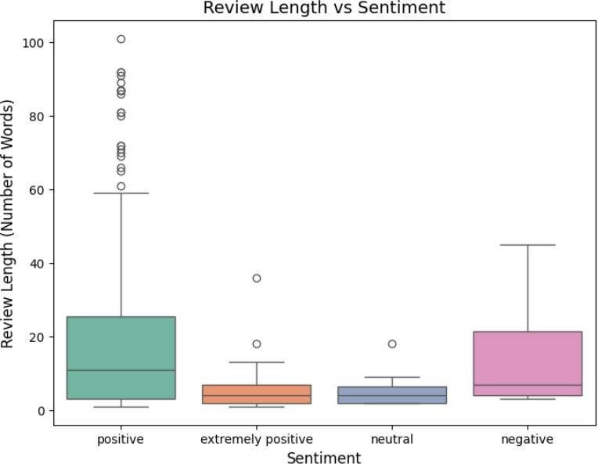
4. Negative
Least frequent sentiment in the dataset. Shows relatively few dissatisfied customers.
Insight:
The chart reveals a strong positive sentiment bias, with "Positive" reviews being the dominant category.
Neutral and Negative sentiments are significantly less common, suggesting overall favorable customer perception of the iPhone 15 128GB.

Slide 15
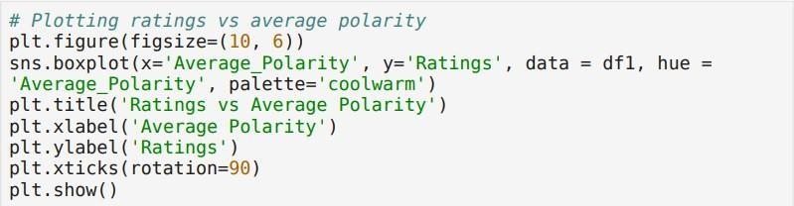
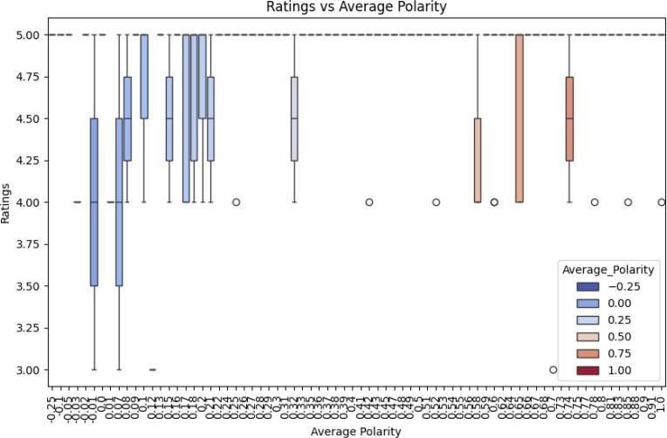
Review Length vs Sentiment Correlation
Positive Reviews
Tend to correlate with higher ratings (typically 4.5–5 stars).
This relationship is evident through clustering patterns and color gradients in visualizations.
Neutral Reviews
Are spread across a wide range of ratings.
Indicate that neutral sentiment does not always correspond to the given star rating. Suggest potential mismatches between textual sentiment and numeric rating.
Negative Reviews
Commonly associated with lower ratings (1–2 stars).
However, variation exists due to subjective interpretations and individual reviewer biases.
Some reviews with negative text may still receive moderate ratings, and vice versa.

Slide 16
Ratings vs Average Polarity
Positive Sentiment
Shows the widest variation in review length.
Contains a few notable outliers with very long reviews.
The median review length is higher than that of other sentiment categories.
Extremely Positive Sentiment
Has the shortest overall review lengths.
Displays a tighter distribution, indicating consistency in review length. Contains fewer outliers, suggesting more uniform feedback.
Neutral Sentiment
Review lengths show a narrower range, similar to the "Extremely Positive" group. Feedback tends to be moderate and concise, with minimal variation.
Negative Sentiment
Exhibits a moderate range of review lengths. The median review length is:
Shorter than "Positive" reviews.
Longer than "Extremely Positive" and "Neutral" reviews.
Interpretation of Review Length vs Sentiment
Positive reviews are generally more detailed and longer. Extremely Positive and Neutral reviews are typically shorter.
Negative reviews vary in length but are usually more concise than Positive reviews.
5. Reporting Structure
Summary of Findings Includes:
Overview of data collection and cleaning. Sentiment Analysis Results:
Distribution of sentiments. Average sentiment per rating.
Insights:
Key trends.
Issues and highlights.
Recommendations:
Product improvement suggestions. Marketing strategy enhancements.

Slide 17
Sentiment Analysis Report: Customer Reviews of the iPhone 15 128GB on Amazon.
Data Collection and Cleaning Process
Data Source:
Customer reviews for the iPhone 15 128GB collected from Flipkart using web scraping
tools like Selenium and BeautifulSoup.
Data Preparation:
Removed unnecessary characters and standardized text formatting. Eliminated excess spaces.
Tokenized text for further analysis. Classified reviews into categories:
Positive
Extremely Positive Neutral
Negative
Extremely Negative
Sentiment Analysis Findings
Sentiment Breakdown
Positive sentiment dominated the dataset (over 200 instances). Extremely Positive followed with fewer entries.
Neutral and Negative sentiments were least frequent.
Sentiment by Rating
Higher star ratings were strongly linked to Positive or Extremely Positive sentiments. Lower star ratings typically reflected Neutral or Negative sentiment—signaling customer dissatisfaction.
Key Insights
Positive Aspects
Customers praised:
Design
Camera quality Overall performance
Many noted battery life improvements as a major benefit.
Common Complaints

Slide 18
Neutral and Negative reviews cited:
High pricing
Delivery and packaging issues
Accessory compatibility problems Minor software glitches
4. Recommendations
Product Enhancements
Fix software bugs reported in reviews. Resolve accessory compatibility concerns.
Marketing Suggestions
Highlight:
Camera quality
Battery performance Sleek design
Offer solutions to pricing concerns:
EMI options Exchange offers
Time-limited discounts
Operational Improvements
Improve delivery logistics to reduce complaints about packaging and delays. Actively monitor customer feedback for timely issue resolution.

Slide 19



